Slide 1
Software requirements:
The software requirements are description of features and functionalities of the target system.
Requirements convey the expectations of users from the software product.
The requirements can be obvious or hidden, known or unknown, expected or unexpected from client’s point of view.
Requirement Engineering:
The process to gather the software requirements from client, analyze and document them is known as requirement engineering.
The goal of requirement engineering is to develop and maintain sophisticated and descriptive ‘System Requirements Specification’ document.

Slide 2
1.1 Requirement Engineering Process
It is a four step process, which includes –
Feasibility Study
Requirement Gathering
Software Requirement Specification
Software Requirement Validation

Slide 3
1) Feasibility Study:
When the client approaches the organization for getting the desired product developed, it comes up with rough idea about what all functions the software must perform and which all features are expected from the software.
the analysts does a detailed study about whether the desired system and its functionality are feasible to develop.
This feasibility study is focused towards goal of the organization.
This study analyzes whether the software product can be practically materialized in terms of implementation, contribution of project to organization, cost constraints and as per values and objectives of the organization.

Slide 4
The output of this phase should be a feasibility study report that should contain adequate comments and recommendations for management about whether or not the project should be undertaken.
It explores technical aspects of the project and product such as usability, maintainability, productivity and integration ability.
2)Requirement Gathering:
If the feasibility report is positive towards undertaking the project, next phase starts with gathering requirements from the user.
Analysts and engineers communicate with the client and end-users to know their ideas on what the software should provide and which features they want the software to include.

Slide 5
3) Software Requirement Specification:
SRS is a document created by system analyst after the requirements are collected from various stakeholders.
SRS defines how the intended software will interact with hardware, external interfaces, speed of operation, response time of system, portability of software across various platforms, maintainability, speed of recovery after crashing, Security, Quality, Limitations etc.
The requirements received from client are written in natural language.
It is the responsibility of system analyst to document the requirements in technical language so that they can be comprehended and useful by the software development team.

Slide 6
SRS should come up with following features:
User Requirements are expressed in natural language.
Technical requirements are expressed in structured language, which is used inside the organization.
Design description should be written in Pseudo code.
Format of Forms and GUI screen prints.
Conditional and mathematical notations for DFDs etc.

Slide 7
4) Software Requirement Validation:
After requirement specifications are developed, the requirements mentioned in this document are validated. User might ask for illegal, impractical solution or experts may interpret the requirements incorrectly.
This results in huge increase in cost if not nipped in the bud. Requirements can be checked against following conditions -
If they can be practically implemented
If they are valid and as per functionality and domain of software
If there are any ambiguities
If they are complete
If they can be demonstrated

Slide 8

1.2 Requirement Elicitation Process:
Requirement elicitation process can be depicted using the folloiwng diagram

Slide 9
1) Requirements gathering - The developers discuss with the client and end users and know their expectations from the software.
2) Organizing Requirements - The developers prioritize and arrange the requirements in order of importance, urgency and convenience.
3) Negotiation & discussion - If requirements are ambiguous or there are some conflicts in requirements of various stakeholders, if they are, it is then negotiated and discussed with stakeholders.
Requirements may then be prioritized and reasonably compromised.
The requirements come from various stakeholders. To remove the ambiguity and conflicts, they are discussed for clarity and correctness.
Unrealistic requirements are compromised reasonably.
4)Documentation - All formal & informal, functional and non-functional requirements are documented and made available for next phase processing.

Slide 10
1.3 Software Requirements:
We should try to understand what sort of requirements may arise in the requirement elicitation phase and what kinds of requirements are expected from the software system.
Broadly software requirements should be categorized in two categories:
1)Functional Requirements
2) Non-Functional Requirements

Slide 11
1) Functional Requirements:
Requirements, which are related to functional aspect of software fall into this category.
They define functions and functionality within and from the software system.
Examples -
Search option given to user to search from various invoices.
User should be able to mail any report to management.
Users can be divided into groups and groups can be given separate rights.
Should comply business rules and administrative functions.
Software is developed keeping downward compatibility intact.

Slide 12
2)Non-Functional Requirements:
Requirements, which are not related to functional aspect of software, fall into this category. They are implicit or expected characteristics of software, which users make assumption of....
Non-functional requirements include -
Security
Logging
Storage
Configuration
Performance
Cost
Interoperability
Flexibility
Disaster recovery
Accessibility

Slide 13
Requirements are categorized logically as
Must Have : Software cannot be said operational without them.
Should have : Enhancing the functionality of software.
Could have : Software can still properly function with these requirements.
Wish list : These requirements do not map to any objectives of software.
While developing software, ‘Must have’ must be implemented, ‘Should have’ is a matter of debate with stakeholders and negation, whereas ‘could have’ and ‘wish list’ can be kept for software updates.

Slide 14
Requirement Analysis:
What is Requirement?
A software requirement is a capability needed by the user to solve a problem or to achieve an objective.
requirement is a software capability that must be met or possessed by a system or system component to satisfy a contract, standard, specification, or other formally imposed documentation.
All stakeholders in a project - developers, end users, software managers, customer managers - must achieve a common understanding of what the product will be and do, or someone will be surprised when it is delivered.

Slide 15
Here are the objectives for performing requirement analysis in the early stage of a software project:
1) From What to How: Software engineering task bridging the gap between system requirements engineering and software design.
2) 3 Orthogonal Views: Provides software designer with a model of:
system information (static view)
function (functional view)
behavior (dynamic view)
3) Software Architecture: Model can be translated to data, architectural, and component-level designs.
4) Iterative and Incremental Process: Expect to do a little bit of design during analysis and a little bit of analysis during design.

Slide 16
Activities for Requirement Analysis:
Requirements analysis is critical to the success or failure of a systems or software project.
The requirements should be documented, actionable, measurable, testable, traceable, related to identified business needs or opportunities, and defined to a level of detail sufficient for system design.
Conceptually, requirements analysis includes four types of activity:

Slide 17
1) Eliciting requirements: the task of communicating with customers and users to determine what their requirements are. This is sometimes also called requirements gathering.
2) Analyzing requirements: determining whether the stated requirements are unclear, incomplete, ambiguous, or contradictory, and then resolving these issues.
3) Requirements modeling: Requirements might be documented in various forms, such as natural-language documents, use cases, user stories, or process specifications.
4) Review and retrospective: Team members reflect on what happened in the iteration and identifies actions for improvement going forward.
Requirements analysis is a team effort that demands a combination of hardware, software and human factors engineering expertise as well as skills in dealing with people.

Slide 18
Here are the main activities involve in requirement analysis:
Identify customer's needs.
Evaluate system for feasibility.
Perform economic and technical analysis.
Allocate functions to system elements.
Establish schedule and constraints.
Create system definitions.

Slide 19
Structured Analysis:
Structured Analysis is a development method that allows the analyst to understand the system and its activities in a logical way.
It is a systematic approach, which uses graphical tools that analyze and refine the objectives of an existing system and develop a new system specification which can be easily understandable by user.

Slide 20
It has following attributes −
It is graphic which specifies the presentation of application.
It divides the processes so that it gives a clear picture of system flow.
It is logical rather than physical i.e., the elements of system do not depend on vendor or hardware.
It is an approach that works from high-level overviews to lower-level details.

Slide 21
Structured Analysis Tools:
During Structured Analysis, various tools and techniques are used for system
development. They are −
Data Flow Diagrams
Data Dictionary
Decision Trees
Decision Tables
Structured English
Pseudocode

Slide 22
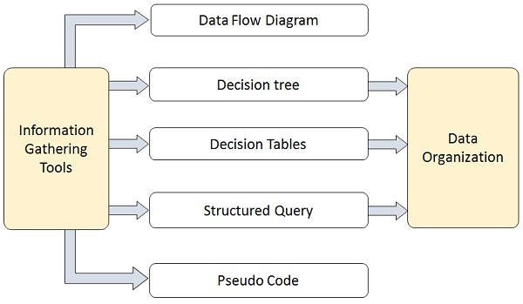

Slide 23
1)Data Flow Diagrams (DFD) or Bubble Chart:
It is a technique developed by Larry Constantine to express the requirements of system in a graphical form.
It shows the flow of data between various functions of system and specifies how the current system is implemented.
It is an initial stage of design phase that functionally divides the requirement specifications down to the lowest level of detail.
Its graphical nature makes it a good communication tool between user and analyst or analyst and system designer.
It gives an overview of what data a system processes, what transformations are performed, what data are stored, what results are produced and where they flow.

Slide 24
Physical DFD
Logical DFD
1) It is implementation dependent. It shows which functions are performed.
2)It provides low level details of hardware, software, files, and people.
3)It depicts how the current system operates and how a system will be implemented.
1)It is implementation independent. It focuses only on the flow of data between processes.
2)It explains events of systems and data required by each event.
3)It shows how business operates; not how the system can be implemented.

Slide 25
Context Diagram:
A context diagram helps in understanding the entire system by one DFD which gives the overview of a system.
It starts with mentioning major processes with little details and then goes onto giving more details of the processes with the top-down approach.
The context diagram of mess management is shown below.

Slide 26
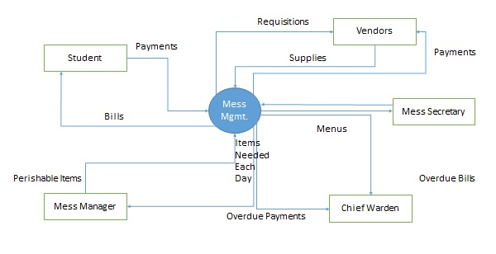

Slide 27
2)Data Dictionary:
A data dictionary is a structured repository of data elements in the system.
It stores the descriptions of all DFD data elements that is, details and definitions of data flows, data stores, data stored in data stores, and the processes.
A data dictionary improves the communication between the analyst and the user.
It plays an important role in building a database.
Most DBMSs have a data dictionary as a standard feature

Slide 28
3)Decision Trees:
Decision trees are a method for defining complex relationships by describing decisions and avoiding the problems in communication.
A decision tree is a diagram that shows alternative actions and conditions within horizontal tree framework.
Thus, it depicts which conditions to consider first, second, and so on.
Decision trees depict the relationship of each condition and their permissible actions.
A square node indicates an action and a circle indicates a condition.
It forces analysts to consider the sequence of decisions and identifies the actual decision that must be made.

Slide 29
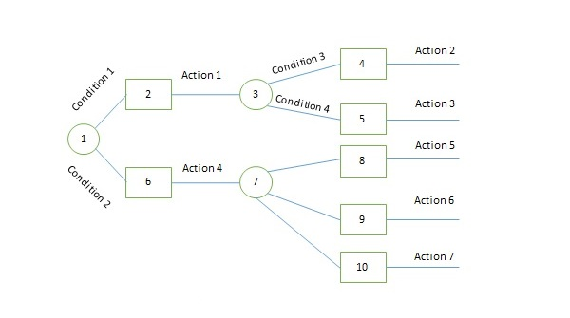

Slide 30
The major limitation of a decision tree is that it lacks information in its format to describe what other combinations of conditions you can take for testing.
It is a single representation of the relationships between conditions and actions.
For example, refer the following decision tree −

Slide 31
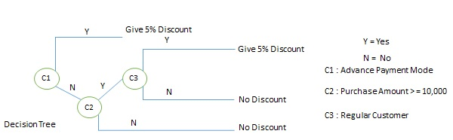

Slide 32
4)Decision Tables
Decision tables are a method of describing the complex logical relationship in a precise manner which is easily understandable.
It is useful in situations where the resulting actions depend on the occurrence of one or several combinations of independent conditions.
It is a matrix containing row or columns for defining a problem and the actions.

Slide 33
Components of a Decision Table
Condition Stub − It is in the upper left quadrant which lists all the condition to be checked.
Action Stub − It is in the lower left quadrant which outlines all the action to be carried out to meet such condition.
Condition Entry − It is in upper right quadrant which provides answers to questions asked in condition stub quadrant.
Action Entry − It is in lower right quadrant which indicates the appropriate action resulting from the answers to the conditions in the condition entry quadrant.

Slide 34
The entries in decision table are given by Decision Rules which define the relationships between combinations of conditions and courses of action.
In rules section,
Y shows the existence of a condition.
N represents the condition, which is not satisfied.
A blank - against action states it is to be ignored.
X (or a check mark will do) against action states it is to be carried out.
For example, refer the following table −

Slide 35
CONDITIONS Rule 1 Rule 2 Rule 3 Rule 4
Advance payment made Y N N N
Purchase amount = Rs 10,000/- - Y Y N
Regular Customer - Y N -
ACTIONS
Give 5% discount X X - -
Give no discount - - X X

Slide 36
5) Structured English:
Structure English is derived from structured programming language which gives more understandable and precise description of process.
It is based on procedural logic that uses construction and imperative sentences designed to perform operation for action.
It is best used when sequences and loops in a program must be considered and the problem needs sequences of actions with decisions.
It does not have strict syntax rule. It expresses all logic in terms of sequential decision structures and iterations.
For example, see the following sequence

Slide 37
if customer pays advance
then
Give 5% Discount
else
if purchase amount >=10,000
then
if the customer is a regular customer
then Give 5% Discount
else No Discount
end if
else No Discount
end if
end if

Slide 38
Pseudocode:
A pseudocode does not conform to any programming language and expresses logic in plain English.
It may specify the physical programming logic without actual coding during and after the physical design.
It is used in conjunction with structured programming.
It replaces the flowcharts of a program.

Slide 39
Guidelines for Selecting Appropriate Tools
Use the following guidelines for selecting the most appropriate tool that would suit your requirements −
Use DFD at high or low level analysis for providing good system documentations.
Use data dictionary to simplify the structure for meeting the data requirement of the system.
Use structured English if there are many loops and actions are complex.
Use decision tables when there are a large number of conditions to check and logic is complex.
Use decision trees when sequencing of conditions is important and if there are few conditions to be tested.

Slide 40
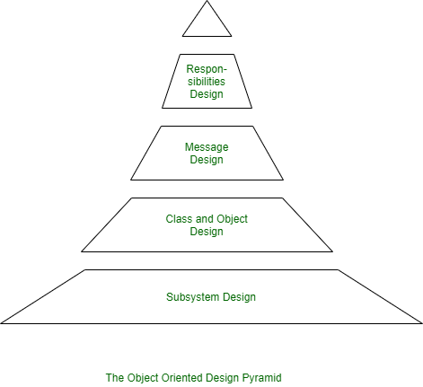
Object-Oriented Analysis (OOA):
An analysis model created using object-oriented analysis is transformed by object-oriented design into a design model that works as a plan for software creation.
In addition, OOD must specify some data organization of attributes and a procedural description of each operation. Shows a design pyramid for object-oriented systems.
It is having the following four layers.

Slide 41
The Subsystem Layer : It represents the subsystem that enables software to achieve user requirements and implement technical frameworks that meet user needs.
The Class and Object Layer : It represents the class hierarchies that enable the system to develop using generalization and specialization. This layer also represents each object.
The Message Layer : It represents the design details that enable each object to communicate with its partners. It establishes internal and external interfaces for the system.
The Responsibilities Layer : It represents the data structure and algorithmic design for all the attributes and operations for each object.

Slide 42
Some of the terminologies that are often encountered while studying Object-Oriented Concepts include:
1. Attributes: a collection of data values that describe a class.
2. Class: encapsulates the data and procedural abstractions required to describe the content and behavior of some real-world entity. In other words, A class is a generalized description that describes the collection of similar objects.
3. Objects: instances of a specific class. Objects inherit a class’s attributes and operations.
4. Operations: also called methods and services, provide a representation of one of the behaviors of the class.
5. Subclass: specialization of the super class. A subclass can inherit both attributes and operations from a super class.
6. Superclass: also called a base class, is a generalization of a set of classes that are related to it.

Slide 43
prototyping Analysis:
Prototyping is used to allow the users evaluate developer proposals and try them out before implementation.
It also helps understand the requirements which are user specific and may not have been considered by the developer during product design.
Prototyping is the process of building a model of a system.
In terms of an information system, prototypes are employed to help system designers build an information system that intuitive and easy to manipulate for end users.
Prototyping is an iterative process that is part of the analysis phase of the systems development life cycle.

Slide 44
Some Advantages of Prototyping:
Reduces development time.
Reduces development costs.
Requires user involvement.
Developers receive quantifiable user feedback.
Facilitates system implementation since users know what to expect.
Results in higher user satisfaction.
Exposes developers to potential future system enhancements.

Slide 45
Some Disadvantages of Prototyping:
Can lead to insufficient analysis.
Users expect the performance of the ultimate system to be the same as the prototype.
Developers can become too attached to their prototypes
Can cause systems to be left unfinished and/or implemented before they are ready.
Sometimes leads to incomplete documentation.

Slide 46
Object Oriented Analysis:(continuation....)
object-oriented analysis phase of software development, the system requirements are determined, the classes are identified and the relationships among classes are identified.
The three analysis techniques that are used in conjunction with each other for object-oriented analysis are
(1)Object modelling
(2)Dynamic modelling
(3)Functional modelling

Slide 47
1) Object Modelling:
Object modelling develops the static structure of the software system in terms of objects.
It identifies the objects, the classes into which the objects can be grouped into and the relationships between the objects.
It also identifies the main attributes and operations that characterize each class.
The process of object modelling can be visualized in the following steps −
Identify objects and group into classes
Identify the relationships among classes
Create user object model diagram
Define user object attributes
Define the operations that should be performed on the classes
Review glossary

Slide 48
2) Dynamic Modelling:
After the static behavior of the system is analyzed, its behavior with respect to time and external changes needs to be examined. This is the purpose of dynamic modelling.
Dynamic Modelling can be defined as “a way of describing how an individual object responds to events, either internal events triggered by other objects, or external events triggered by the outside world”.
The process of dynamic modelling can be visualized in the following steps −
Identify states of each object
Identify events and analyze the applicability of actions
Construct dynamic model diagram, comprising of state transition diagrams
Express each state in terms of object attributes
Validate the state–transition diagrams drawn

Slide 49
3)Functional Modelling:
Functional Modelling is the final component of object-oriented analysis. The functional model shows the processes that are performed within an object and how the data changes as it moves between methods.
It specifies the meaning of the operations of object modelling and the actions of dynamic modelling. The functional model corresponds to the data flow diagram of traditional structured analysis.
The process of functional modelling can be visualized in the following steps −
Identify all the inputs and outputs
Construct data flow diagrams showing functional dependencies
State the purpose of each function
Identify constraints
Specify optimization criteria

Slide 50
Requirement specification:
The requirement specification should state what the stakeholders of the product need in terms of features, functions, performance, constraints, and quality, written in terms of what the product must do or qualities it must have.
These stakeholders, including customers, users, maintenance, tech support and others, have the knowledge to define these requirements.
Sometimes these stakeholders state their requirements in terms of design, often unintentionally.
There are requirement best practices for correcting this problem and for giving the designers the latitude to define the best solution.

Slide 51
Requirement specification, also known as documentation, is a process of jotting down all the system and user requirements in the form of a document.
These requirements must be clear, complete, comprehensive, and consistent.
During the capturing activity, we gather all the requirements from various sources. During the analysis and negotiation activities, we analyze and understand those requirements.
Now, we must prepare a formal document explaining those requirements. That is what the requirement specification is.

Slide 52
The Benefits of Having a Requirements Specification?
Helps to ensure that all stakeholders have a common understanding of the system that is to be developed. This avoids any misunderstanding during later stages of development.
Serves as a reference point for all stakeholders during the development process.
Helps to identify any gaps in the requirements at an early stage.
Reduces the overall cost and time of development as it avoids rework due to changes in requirements.

Slide 53
Requirement Validation:
Validation answers the question, “Are we building the right system?” Requirements validation is the process of checking that the defined requirements are for development, and defining the system that the customer really wants.
Requirements validation helps us detect errors at an early stage of product development so that it does not result in excessive rework when detected later in the system development life cycle.
we will look at what Requirements Validation is, its Process, and various Tools used for Requirements Validation.
Requirements validation: Have we got the requirements right?
Requirements analysis: Have we got the right requirements?

Slide 54
VALIDATION:
Validation is the process of confirming that an item (a system, a work product or a part thereof) matches its stakeholders’ needs.
In Requirements Engineering, validation is the process of confirming that the documented requirements match their stakeholders’ needs; in other words:
whether the right requirements have been specified.
VERIFICATION:
Verification is the process of confirming that an item (a system, a work product, or a part thereof) fulfills its specification.
Requirements verification is the process of confirming that the requiremets
have been documented properly and satisfy the quality criteria for requirements; in other words:
whether the requirements have been specified right.

Slide 55
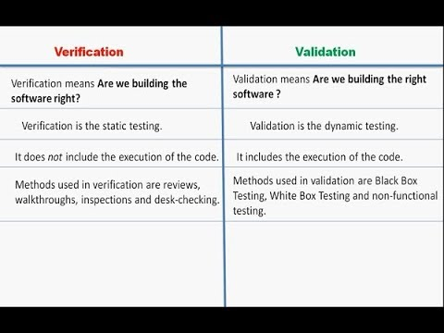

Slide 56
Requirements management:
Requirements management is the process of gathering, analyzing, verifying, and validating the needs and requirements for the given product or system being developed.
Successful requirements management ensures that completed deliverables meet the expectations of the stakeholders.
Requirements can be managed using documents, however, complex systems or products in highly regulated industries mitigate risk by using trusted requirements management tools.
Requirements management is important because it empowers everyone to clearly understand stakeholder expectations and confidently deliver a product that has been verified to meet the requirements and validated to meet the needs.

Slide 57
Benefits of requirements management include:
Enhance understanding of stakeholder needs, requirements, and expectations and the problem or opportunity the product means to address
Gain clarity on scope, budget, and schedule
Minimize costly, time-consuming rework
Increase product quality
Mitigate risk
Improve likelihood of delivering the right product, within budget and schedule with the required quality

Slide 58
Requirements management is making sure the product is the right product and that it is built right.
The goal of the product development process is to create a successful product that meets stakeholder, customer, and market needs.
The requirements management piece of product development includes managing the needs and requirements so that the product meets stakeholder expectations.
Therefore, needs and requirements along with budget and schedule set the scope for the project.
However, the domain of project management encompasses tasks like providing budget, personnel, and resources needed to develop the product.

Slide 59
UNIT 2 THE END

